Slide 1








Status-page infrastracture
Project Timeline
1
learn status-page application
5
CI/CD
2
Design the Architecture
6
Budget
3
Infrastructure as Code
7
Next sprint
4
Monitoring/logging

Slide 2
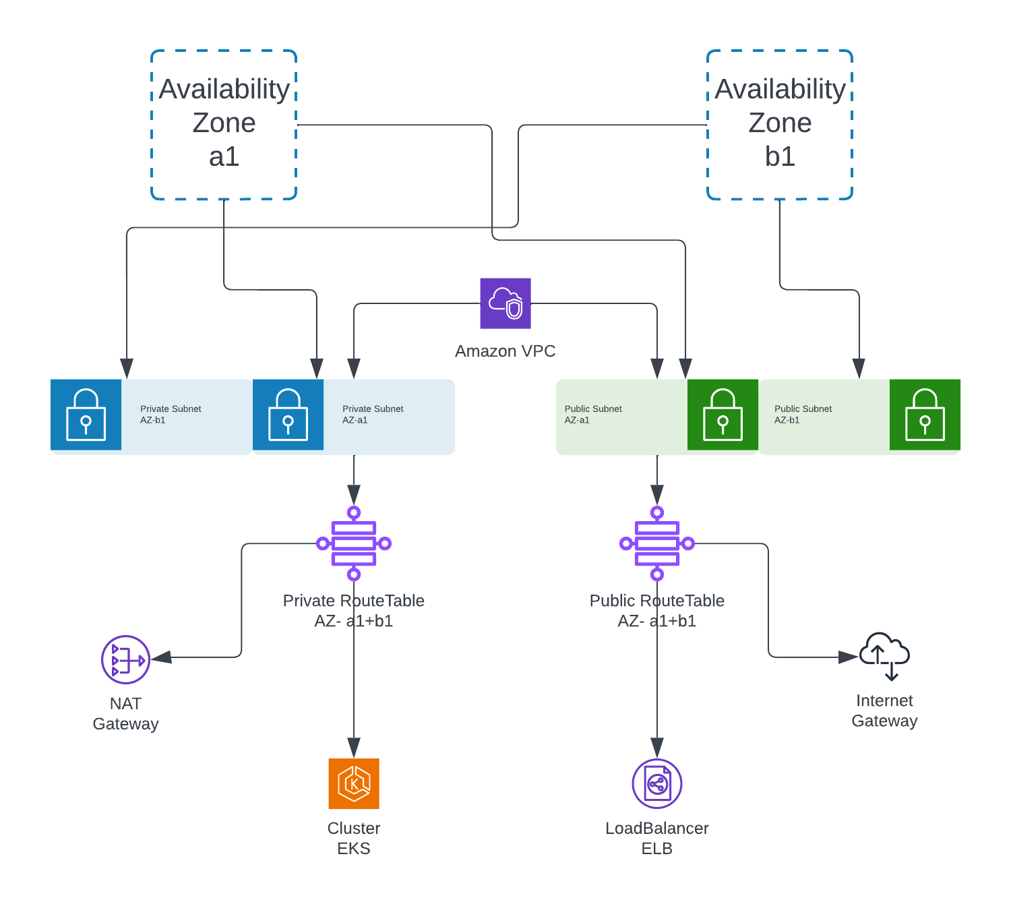

Slide 3
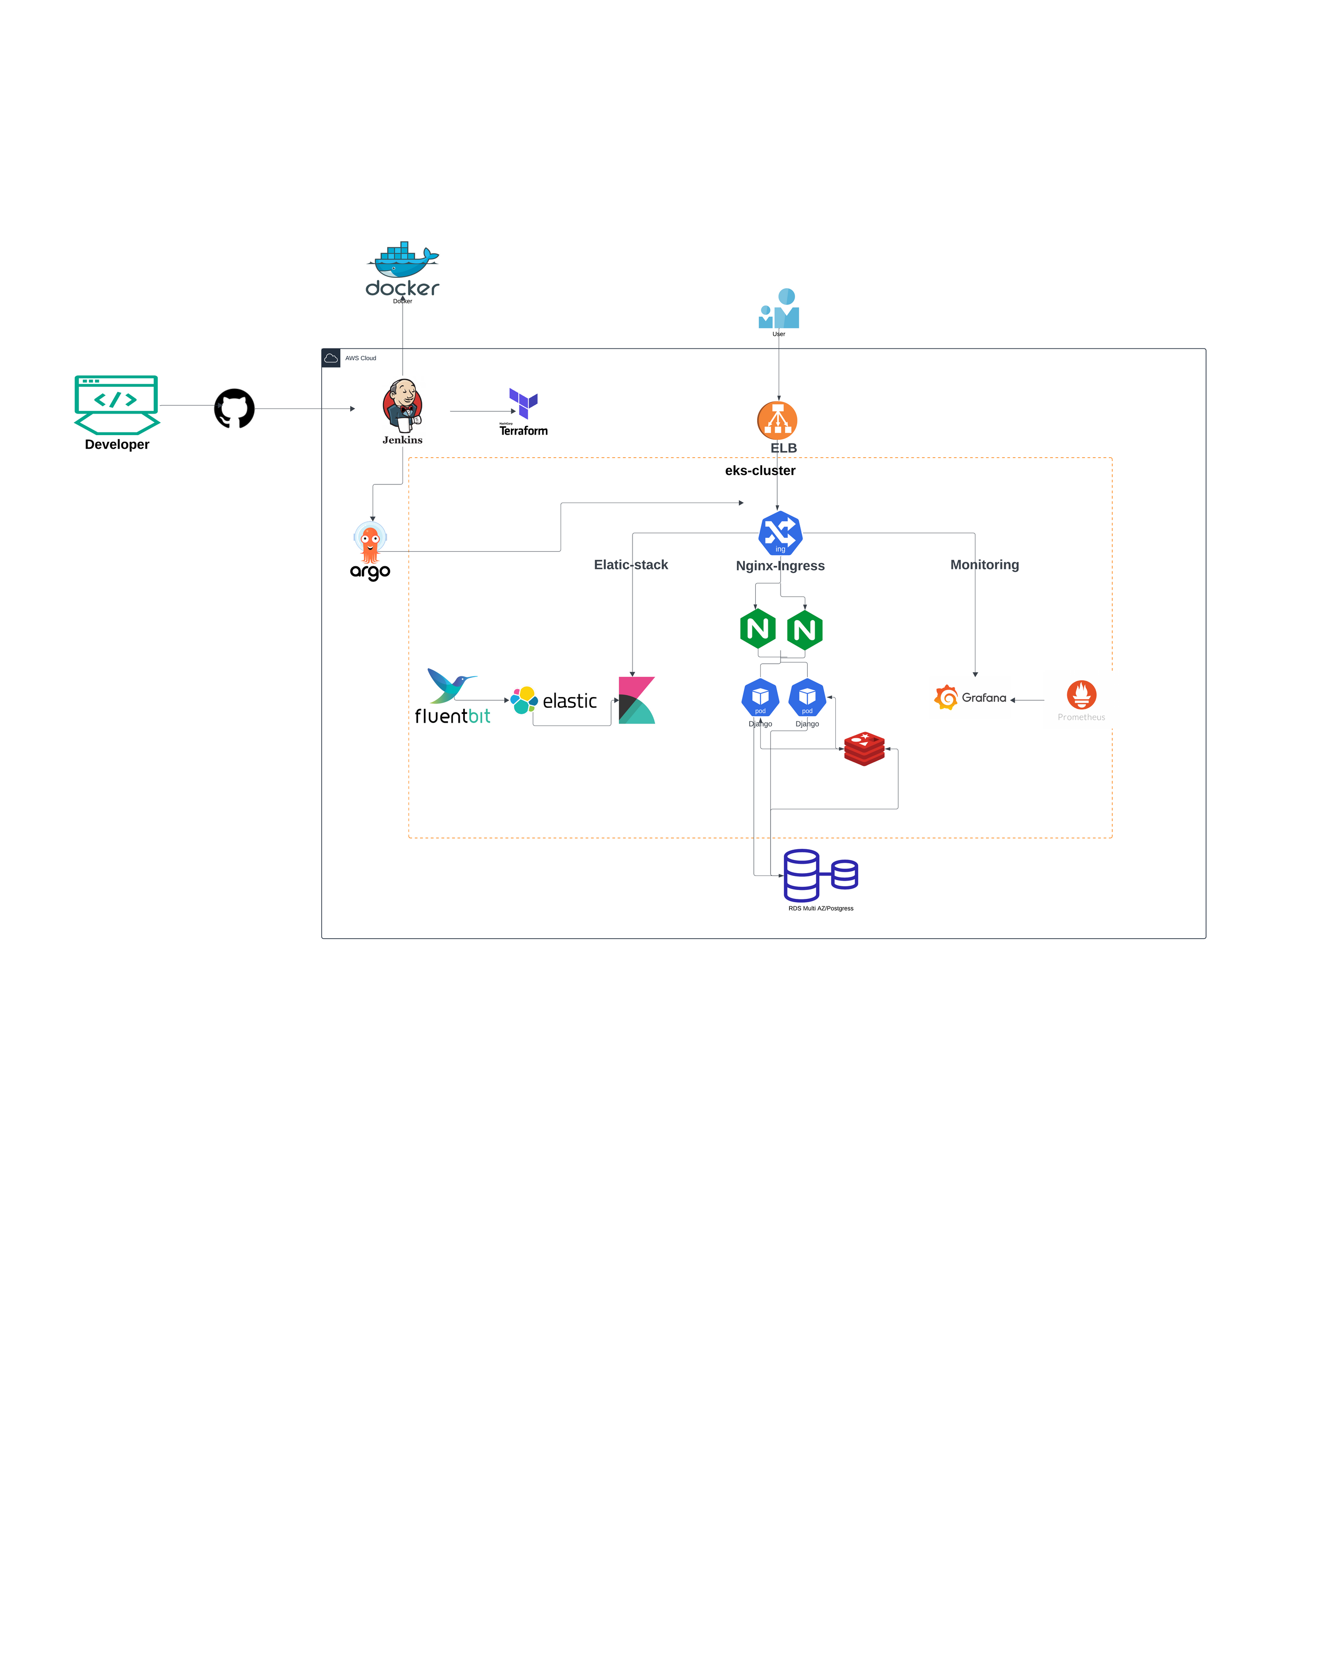

Slide 4
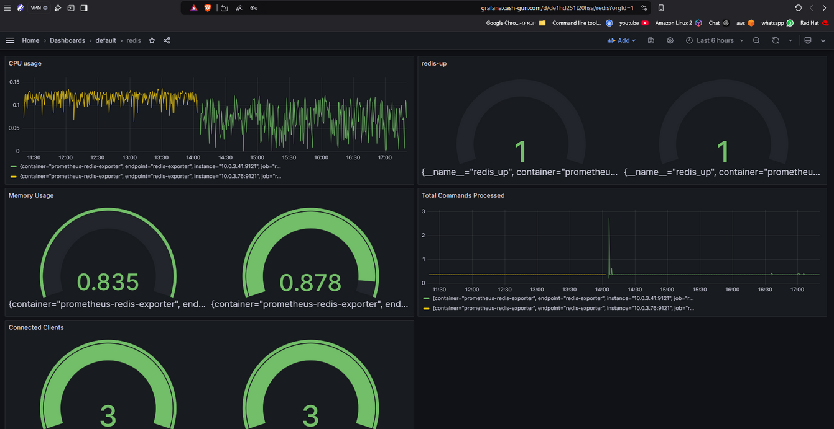
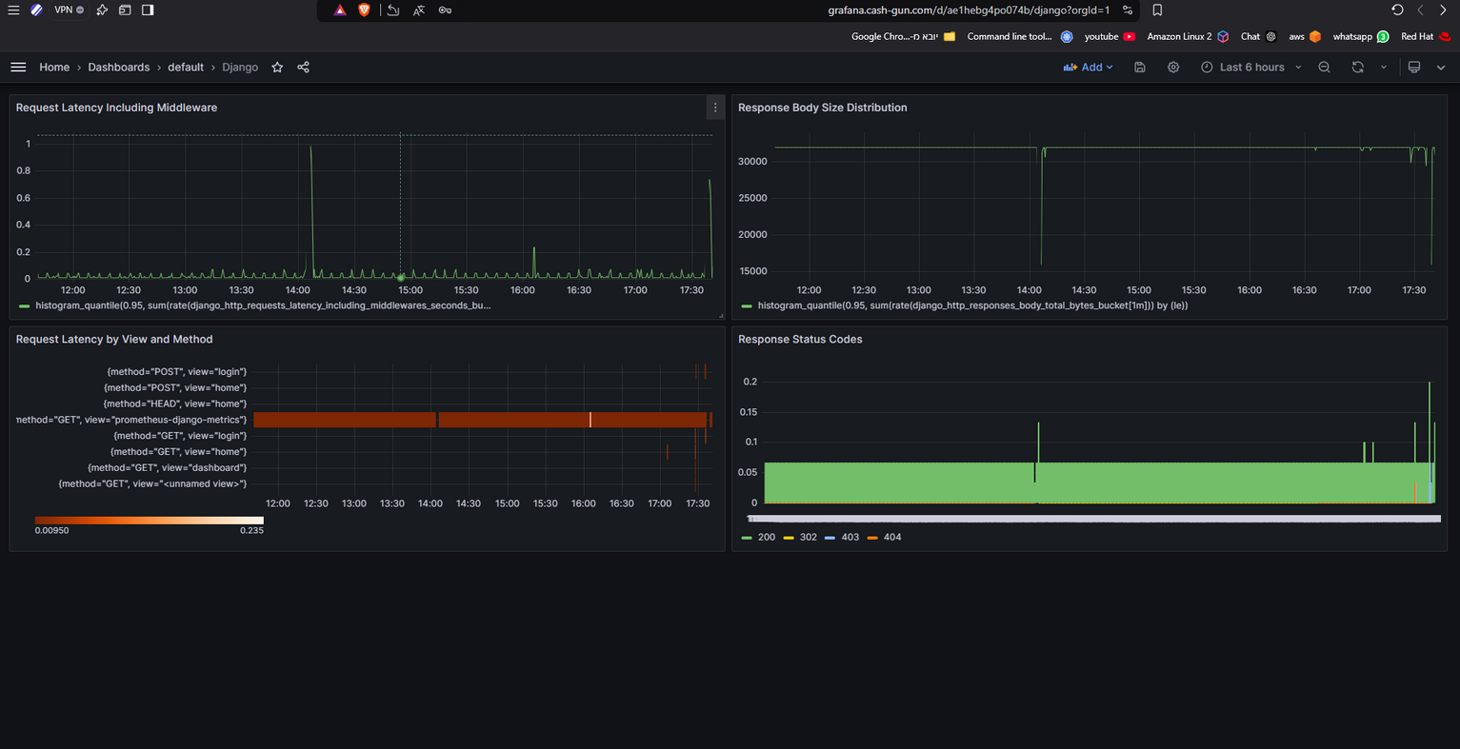

Slide 5
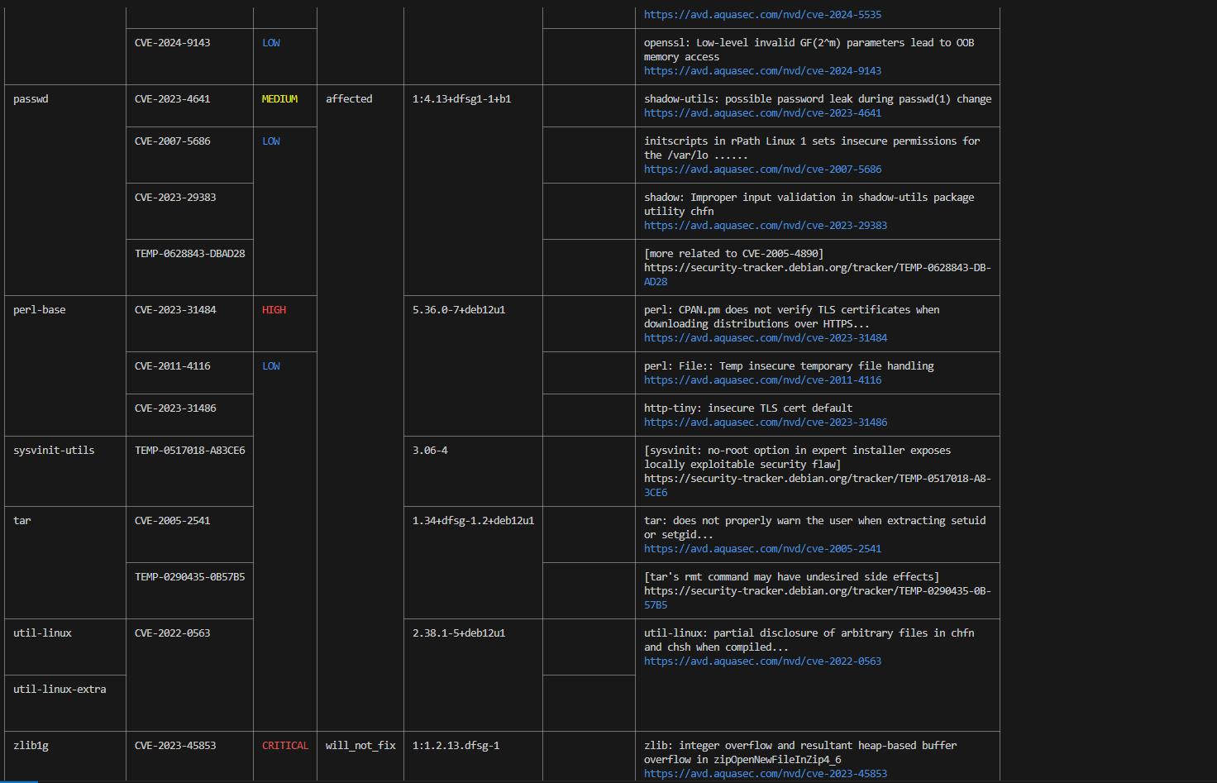

Slide 6
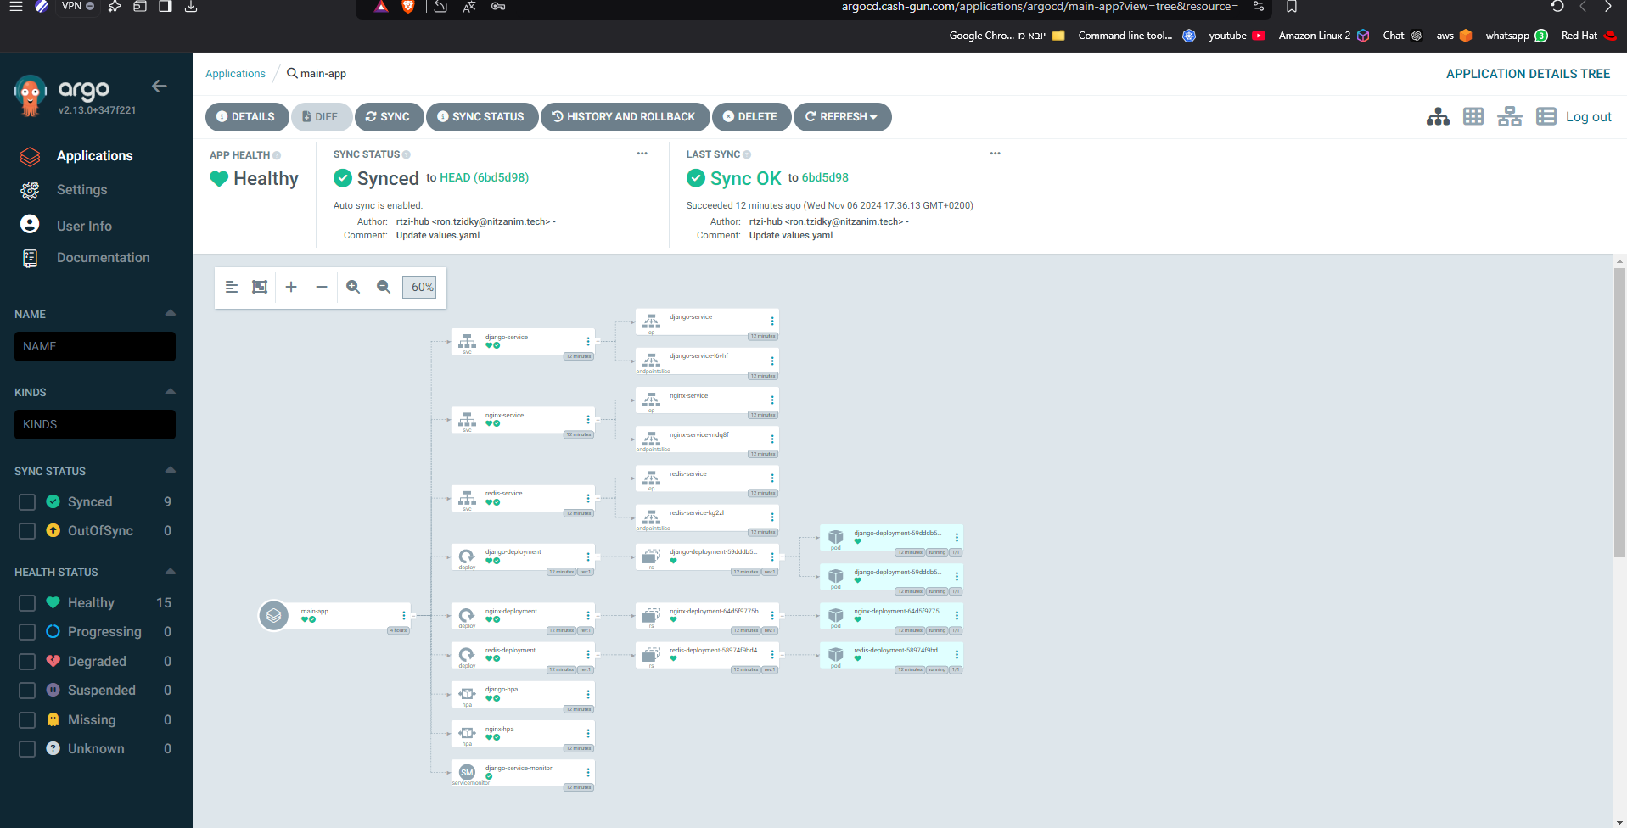
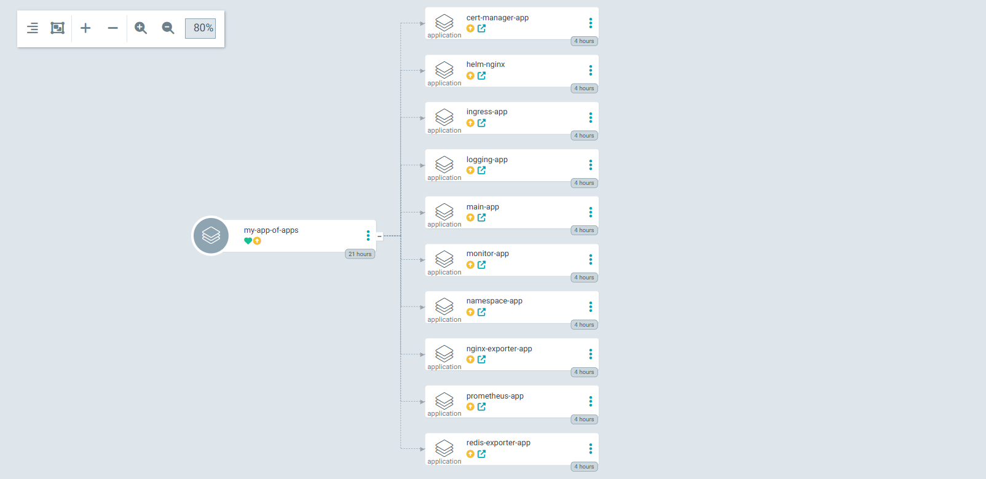

Slide 7
Monthly budget
vpc + NAT = 30$
3 EC2 t2.medium = 67.89$
EKS = 70$
ELB - 100K Requests = 18.5$
RDS t3.micro - 20GB = 16$
total cost = 202.39$

